Slide 1

Kofax Intelligent Automation Platforms
Express/Capture / TotalAgility/ RPA
David.Wright@Kofax.com
Partner Development Manager
Notes:
Winning the Customer in the Cognitive/AI/RPA World.
Session Goals :Understand and articulate the value of focusing on human performance rather than machine performance in RPA & CDA opportunities.
Various Case Studies to make the problem very clear.

Slide 2
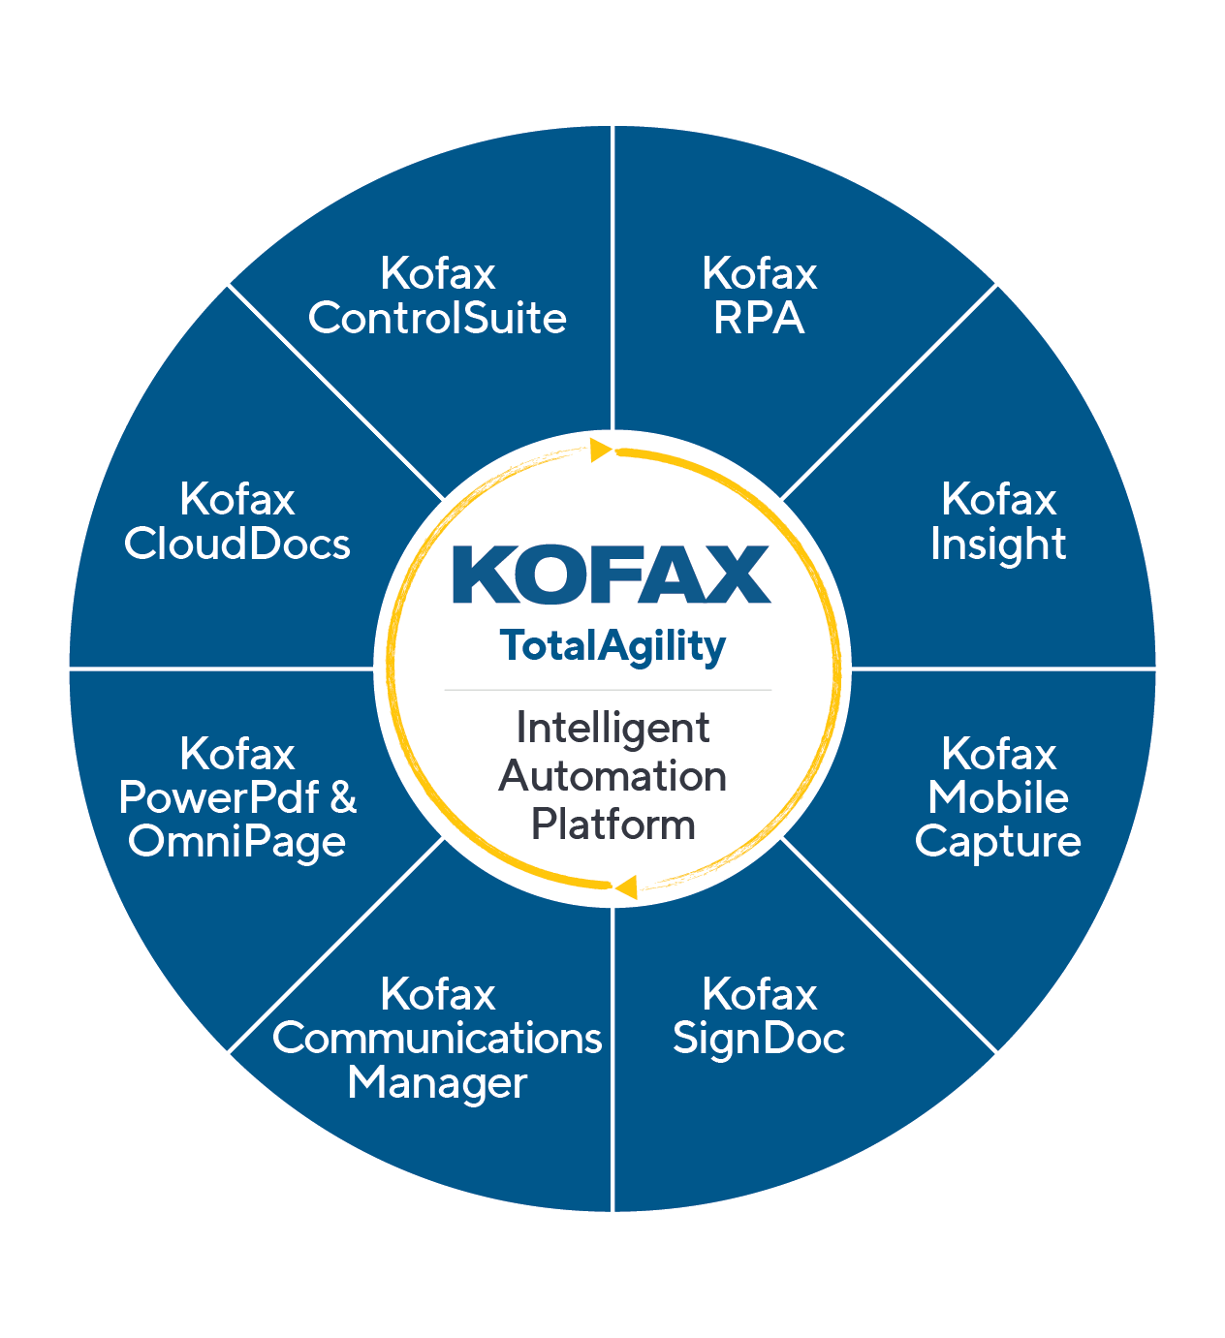
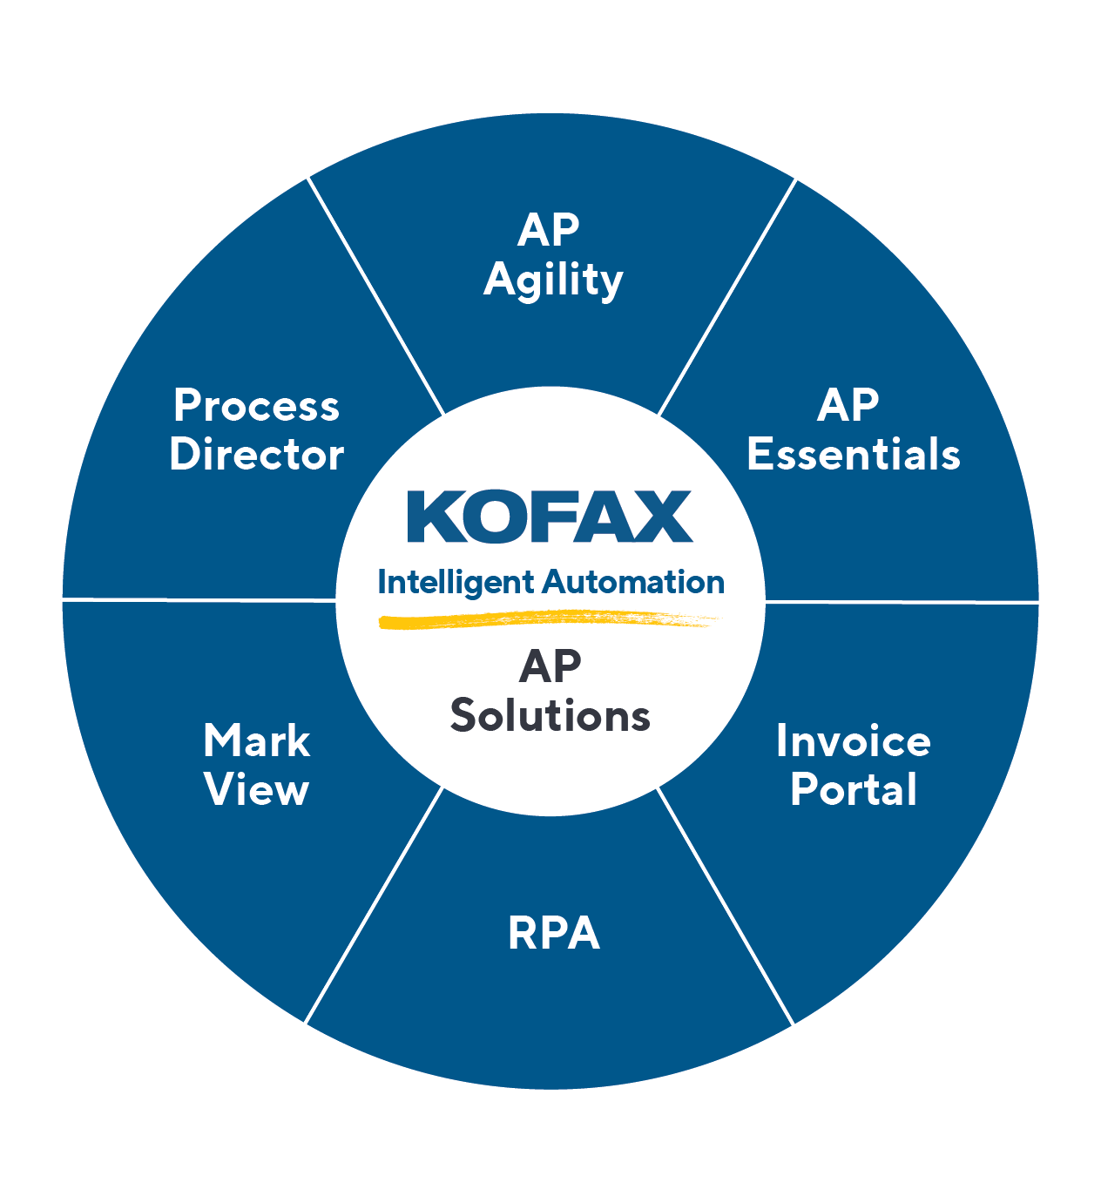
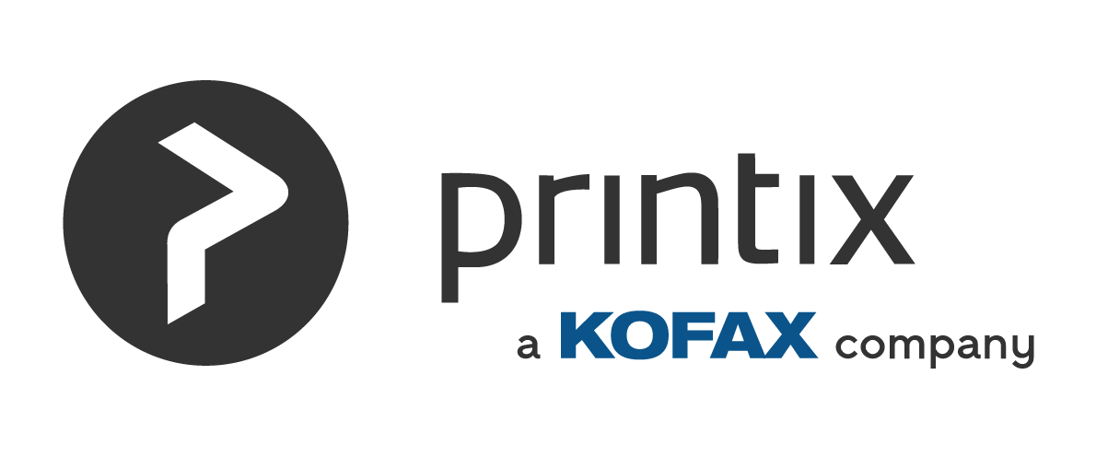
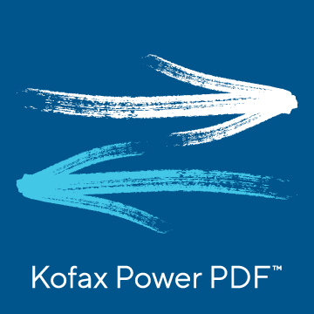
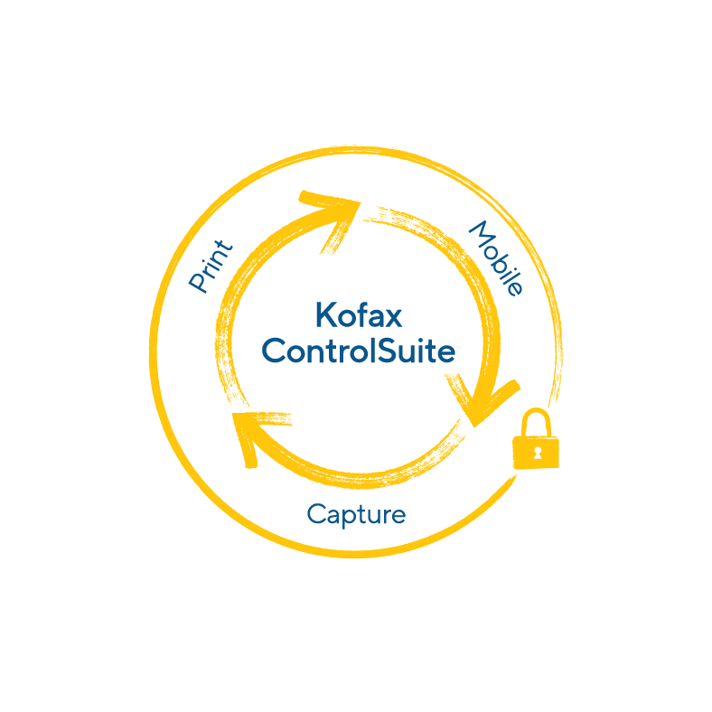
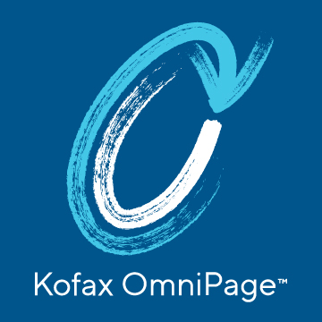

Our Automation Portfolio digitally transforms Content-Intensive Workflows… and differentiates us from the Competition
Kofax Automation
Intelligent Automation
Print Automation
Intelligent Automation Platform
Accounts Payable Solutions
Print Infrastructure & Management Platforms
Productivity Solutions
a global B2B e-invoicing network
Notes:
Throughout ‘22 we will continue to strengthen the integration of our comprehensive Automation portfolio that provides you the ability to penetrate different LOB customers with up and cross-sell potential
We will continue to win in the enterprise and SMB markets by focusing on what differentiates us from the competition
And what differentiates Kofax is our ability to use our Cognitive Capture heritage, coupled with our Workflow Orchestration strategy…to transform content-intensive workflows
This stands true across IA, AP, PA and Productivity
Focusing on Digitally Transforming ‘Content-Intensive’ Workflows is the way we expand from back-office document imaging use cases to front office complex content-intensive use cases WHILE differentiating ourselves from other Workflow solutions

Slide 3






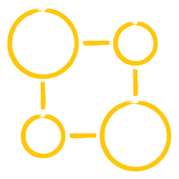


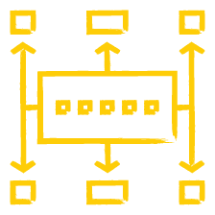
Leading Fully Integrated Intelligent Automation Platform Driving Digital Workflow Transformation
Kofax’s primary product offering is its Intelligent Automation Platform, a low-code end-to-end solution for process automation driving digital workflow transformation, differentiated via its power, simplicity and depth of document intelligence
Intelligent Automation Platform
Key Products and Capabilities
 | Kofax TotalAgility | Process & Dynamic Case Management to orchestrate digital workflows; integrates with any enterprise software application or system
 | Kofax RPA | Automates desktop automation of repetitive tasks in an attended or unattended manner
 | Kofax Insight | Analytics to monitor, analyze and optimize operational business processes and decisions
 | Kofax Mobile Capture | Image capture, data extraction and ID verification on mobile devices
 | Kofax SignDoc | Enables secure and legally enforceable eSignature capabilities in electronic documents
 | Kofax Communications Manager | Automates outbound electronic omni-channel personalized customer correspondence for eSignature, disclosure, resolving inconsistencies and other purposes
 | Kofax Power PDF & OmniPage | Desktop productivity capabilities for data extraction via OCR to convert paper and electronic documents into digital PDF and other files with save, edit and search functionalities
 | Kofax CloudDocs | Enterprise cloud storage and file management solution
 | Kofax Control Suite | Print management and capture on MFDs
9
2
1
Kofax
Control
Suite
2
Kofax
RPA
8
3
3
Kofax
CloudDocs
Kofax
Insight
4
1
TotalAgility
5
Kofax Power PDF &
OmniPage
Intelligent Automation Platform
Kofax
Mobile
Capture
7
4
6
Kofax
Communications Manager
Kofax
SignDoc
7
6
5
8
9
Notes:
POTENTIAL Q&A
Q1: Are all the products within the IA Platform deployable via Cloud? If not, what does the roadmap look in terms of timing to make all products Cloud-ready?
Q2: Which of these products are in highest demand / exhibiting most growth? Which products generate the most revenue for Kofax?

Slide 4
Portfolio Architecture and Key Platform Integrations
Portfolio Architecture
Key Integrations
Enterprise Applications
Intelligent Automation
Print Automation
Capture products provide shared infrastructure for higher level products
Tight integration with TotalAgility to coordinate all Intelligent Automation services
AP Agility built on Intelligent Automation platform
TotalAgility provides advanced workflow & document processing to ControlSuite
Power PDF can submit documents to ControlSuite and to Intelligent Automation (for eSignature)
1
4
TotalAgility
RPA
2
AP Agility
Design Studio
Client UX Services
ControlSuite
Analytics (Insight)
3
Customer Communications
3
AP Essentials
Process Orchestration Service
Printix
2
5
eSignature (SignDoc)
4
Process Repository
5
Mobile
Power PDF
5
1
1
1
Shared Capture Services
Omnipage Capture SDK
Atalasoft
Virtual Rescan (VRS)
Transformation
Integration
Service

Slide 5
We provide a portfolio of automation products to deliver to these use cases
Enterprise Applications
Intelligent Automation Platform
Print Automation
AP Essentials
TotalAgility
Printix
AP Agility
RPA
ControlSuite
Invoice Portal
eSignature
Power PDF
Invoice OCR
AP Workflow
E-invoicing Compliance
ERP Connectors
Intelligent OCR
Case Management / Workflow
Task Automation
Secure Print
PDF management
Notes:
We lead with our IA Platform and the core of that is TotalAgility, which is our engine for case management and low code workflow with embedded AI powered capabilities for intelligent document processing. It also has deep technical integrations to the end to end automation capabilities we provide for RPA, for analytics, for electronic signature, for document cloud storage, and customer communications which gets our customers again to this very differentiated and comprehensive set of capabilities that they can deploy across their business.
We then extend the IA platform with distinct enterprise applications that we deploy as the use-cases call for them. This includes our vertical and use case specific solutions which we continue to grow, along with our solutions for print management and productivity including PDF management capabilities.
One thing that is important to understand is that our platform can be deployed in a modular fashion or end to end. Our commercial terms support that…so customers can pick which technologies they want to buy when they are ready.
Entire Platform is Cloud-Ready via one-click script it can be containerized and deployed to cloud of the customers choosing
Customer Buyer personas are equally divided between CIO or Technical buyers and LOB DT leaders for the IA Platform and more LOB buyers for AP enterprise apps.

Slide 6
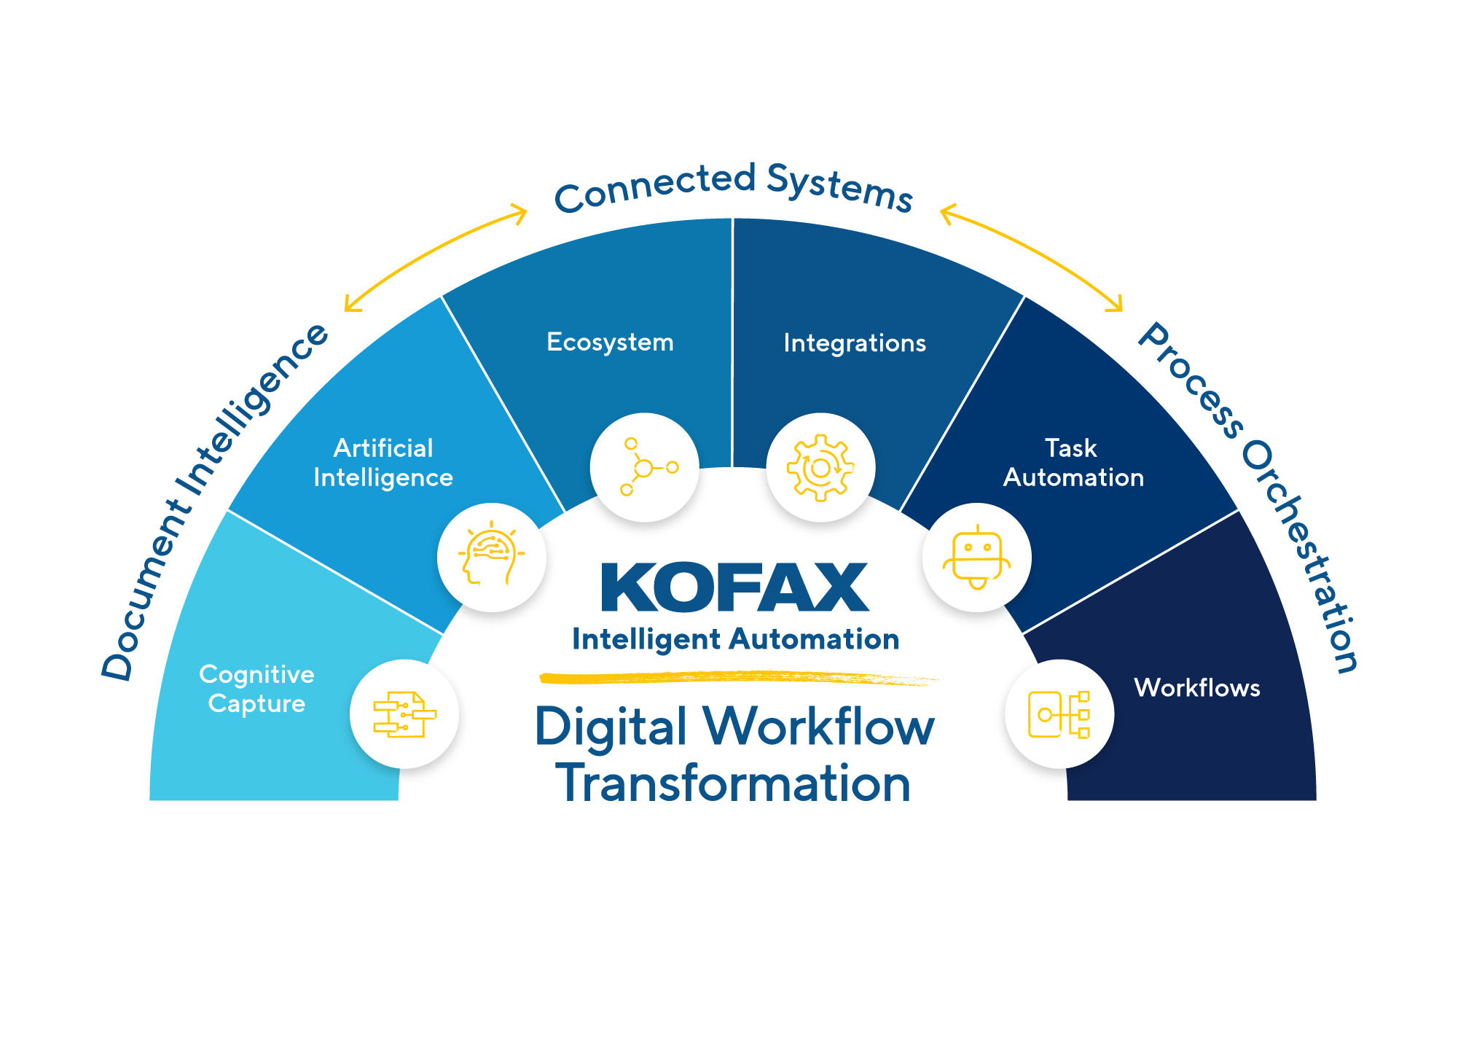
The Kofax IA platform is positioned to digitally transform content-intensive workflows
Market Positioning
Unique Selling Proposition:
An Intelligent Automation Platform for managing Content Intensive Workflow
Notes:
This slide introduces the Kofax Intelligent Automation Platform.
Following up on the previous slide, Kofax delivers the needed complimentary technologies in a single platform built, around TotalAgility.
No other vendor can claim the range of technologies listed in the slide in a single, integrated platform.
Three key technologies will drive automation solutions:
AI, to drive document intelligence
Cloud, to enable fast deployments and flexible deployment options
Low-code, to expand workflow development capabilities across entriprises
Takeaway: Kofax is a leader in intelligent automation and the only vendor to offer AI, RPA, low-code and e-signature in a single, integrated platfrom.
Next slides: Overview of TotalAgility capabilities across Document Intelligence, Connected Systems and Process Orchestration

Slide 7








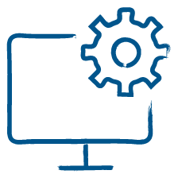


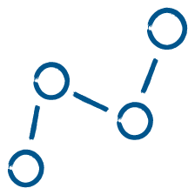

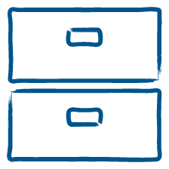

Content workflow capabilities that span a broad set of use cases
Workflow Orchestration
Pre-Processing
Classification
Extraction
Post-Processing
Human-in-the-loop for verification and correction
Incoming Documents
Incoming Documents
Image
pre-processing
Data capture
Indexing & classification
Extraction of relevant data
Data validation
Structured data
Powering Technologies
Powering Technologies
Auto-crop, noise reduction, etc.
Computer vision and Optical Character Recognition (OCR)
Text mining & machine/deep learning
NLP & machine/deep learning
Internal / external business validation rules
Structured data feed to downstream applications (ERP, CRM, SAP Legacy system, etc.) via API or RPA

Slide 8
Kofax Capture 1995-
Linear workflows
Additional components
Email import, folder import, PDF, compression, Split, Merge
Kofax Transformation Modules
Extraction, Document Review, Correction, Validation, Verification, Learning
Scan
Extract
Validate
Export

Slide 9
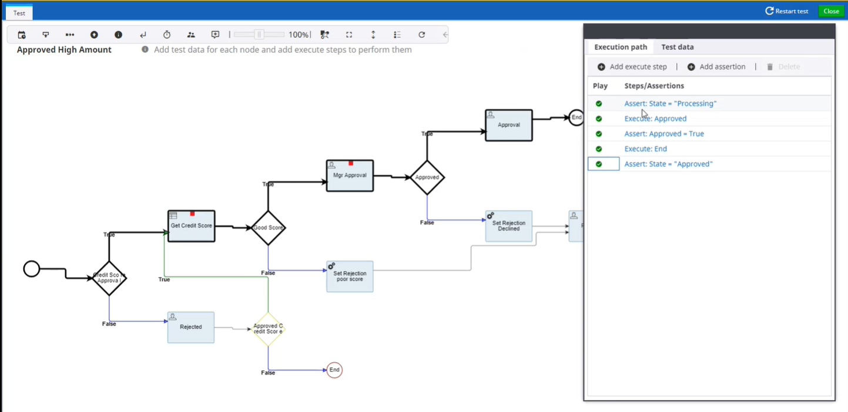
Kofax Total Agility 2011-
Complex workflows with humans, documents, devices, systems, business rules engines,
Case management over months
Duplicate detection
Missing page handling
Approval, escalation

Slide 10
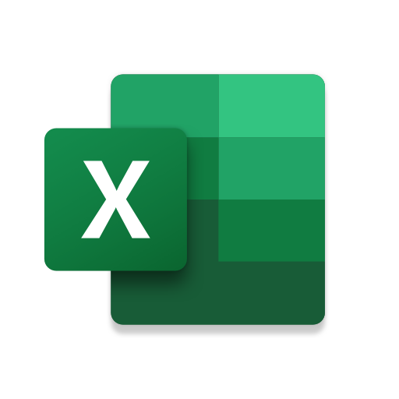

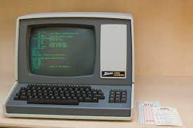
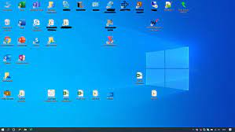


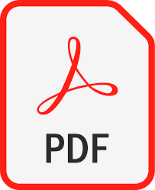
Kofax RPA – Robotic Process Automation – 2012
websites terminals windows desktop Excel

Slide 11
RPA
GET →CHANGE → PUT
Copy Excel to Web
Copy Web to Excel
Copy Excel to SAP
Copy SAP to Web
Copy Excel to Terminal
Copy PDF to SAP
Copy PDF to Web.

Slide 12
Quiz
Use Case | Platform
Scan to Archive | KC
Approve invoices | KTA
Make searchable PDFs from paper | KC
Copy data from a website into Excel | RPA
Check an inventory item on a green screen terminal | RPA
Integrate an MPF device into a complex workflow | KTA
Guide a customer through mortgage application | KTA
Process questionnaires | KC

Slide 13




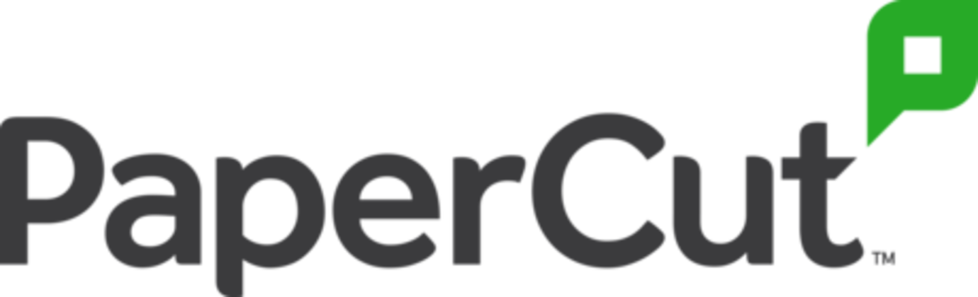

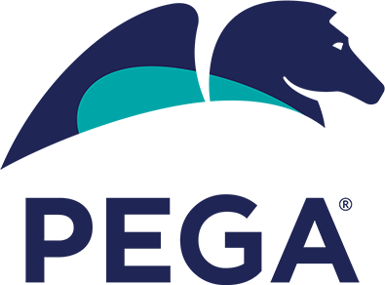


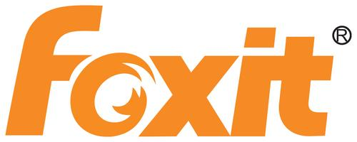





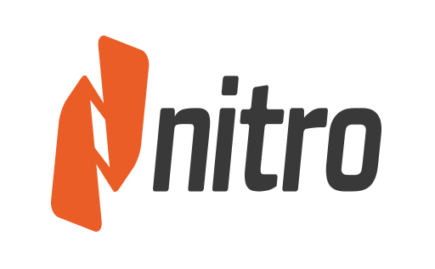

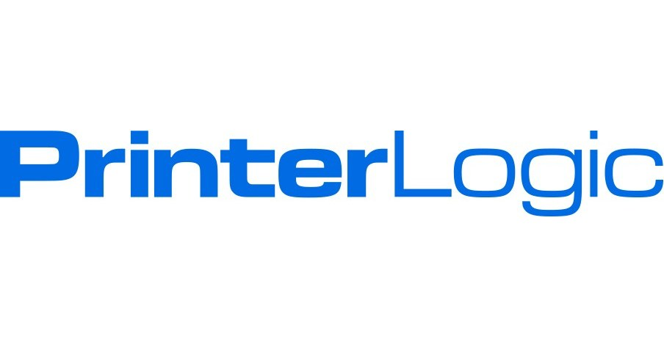

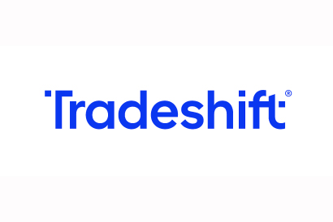
Competitive Landscape and Kofax’s Key Differentiators
Intelligent Automation Portfolio
Print Automation Portfolio
Capture
BPM
RPA
AP Automation
Print Automation
Productivity
Key Competitors
Kofax Differentiators
Fully integrated horizontal Intelligent Automation platform to develop, deploy, maintain, administer and scale ONLY ONCE = faster time-to-value Embedded cognitive capture and Artificial Intelligence – NLP and ML capabilities Intelligent Automation extensibility allows Kofax to extend across multiple ERPs | Only vendor that uniquely integrates full capture and print capabilities on MFDs and supports mixed fleets | Reputation for quality, reliability and ease of use Provides best-in-class PDF security Multiple licensing options
Source: Company websites.
Notes:
POTENTIAL Q&A
Q1: Across this spectrum of offerings, where are you gaining share / losing share? Which competitors do you see the most within each segment?
Q2: How do you win in the RPA market vs. steep competition like UiPath, Automation Anywhere and Blue Prism?
Q3: What does your growth profile look like vs. competition within each segment?

Slide 14




Company Focus Areas
Customer Experience and Low-Code
Cloud and SaaS Workflow
Technology Innovation and AI

Slide 15
Customer & Partner Experience
We are increasing the ease, efficiency, and effectiveness of doing business with Kofax…
1
2
3
4
Improving our InfoSec Messaging
Kofax Trust website
Cloud certification investments + enablement
Internal InfoSec / RFX coordination
Redesigning for Cloud Customers
Cloud pricing enhancements
Cloud Product / Capabilities expansion
KTA Cloud trial experience
Simplifying Our Delivery
Pre-defined PS Packages
Role-based Training
Cross-functional customer workflows
Investing in Our Partners
Enhanced Partner loyalty benefits
Expanded offerings
KTA Cloud Partner program
Notes:
All successful ‘Perpetual to Recurring’ shifts focus on transforming two key components concurrently…SW licensing transformation, selling ToP/SaaS over Perp, AND Operating Model Transformation, delivering experiences that subscription customers demand
In ‘21 we invested in the CX Program to centrally manage the E2E customer & partner journey to make it easier to do business with Kofax, with an end-goal of helping you SELL FASTER AND BIGGER. Let’s talk about a few initiatives:
<click> First, we made it easier for customers to learn about and be comfortable with our InfoSec posture
We launched the ‘Kofax Public Trust’ webpage to provide customers a real-time view into our certifications, security, privacy, and system status information.
We invested in Cloud Certifications, attaining SOC 2 Type 2 for AP Essentials, KTA Cloud, and SignDoc Cloud AND will be pursuing ISO27001 in ‘22 for these same products WHILE ALSO seeking SOC 2, Type 2 for PrintIx.
We are streamlining the InfoSec / RFX coordination process so you’re able to deliver consistent and high quality responses to your customers
<click> Second, we are redesigning our business for Cloud Customers.
We’re improving our cloud pricing to better align with the market and ultimately make us more competitive
We introduced 2yrs of low code investments in KTA 7.9 Quick-Apps - so customers, especially LOB non-technical users, can access and scale our platform
We are also revamping the KTA Cloud trial experience…which will allow prospects to easily evaluate KTA Cloud
<click> Third, we are simplifying and streamlining our delivery to be more responsive to our customers
We are rolling out more pre-defined PS packages and upgrading to a role-based training model
We’re also streamlining cross-functional work…to minimize the time Sales Reps serve as Project Managers when requesting assistance from the business. We’re starting by streamlining the ‘Request Estimate’ process when Professional Services is attached to a deal and for the ‘Sales to new Customer Success Manager’ handoff process.
<click> Forth, we are investing in our Partners
We are rewarding loyalty by increasing discounts for higher performing partners
We are expanding partner offerings to include cloud products…beginning with KTA Cloud, AP Essentials, PrintIx, SignDoc Cloud and PSI Safe
And we are rolling out the KTA Cloud partner program
While all these initiatives indicate a step in the right direction…I realize we have more to do…so our CX Program will continue working diligently across Kofax to best position you for success

Slide 16
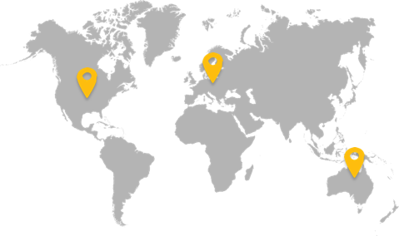
Customers Are Accelerating Their Journey to KTA Cloud
82% growth in New Cloud Customers since 2018
2,000% Growth in Documents Processed in 2021
50 Million Pages of Documents Processed in 2021
KTA cloud is available in all 3 geos
Notes:
154
Data points for TotalAgility Cloud

Slide 17


Kofax Solution Alignment
Cloud Print Management
Print & Output Management
Intelligent Capture
Workflow Automation
Digital
Transformation
Capture / Print / Workflow / Mobility
Kofax AP Essentials / AP Agility
Kofax TotalAgility / RPA / Insights
Kofax Power PDF - SignDoc
Kofax Mobility
Kofax OCR
Office Automation
AP Automation
Intelligent Automation

Slide 18
We Continue to Execute the Intelligent Automation Strategy we crafted in 2018
2018
Today
Capture-Oriented Disparate Solutions
Intelligent Automation Platform & Ecosystem
On-Premise Software
Cloud-Ready – Private and Public
Perpetual Licensing Focus
Recurring Revenue Focus
Notes:
If we think back to 2018 when we crafted our current Intelligent Automation market positioning…we only had a few guiding principles:
<click> We agreed to shift from leading with Capture-Oriented solutions to leading with an integrated IA platform & ecosystem <click x2>
We agreed to move from on-premise software to cloud-ready SW capable of supporting private and public cloud <click x2>
And the last piece…was to modernize our operating model to be more market-aligned and customer-centric…and we’re doing that right now as we shift to a recurring revenue business model
With your leadership, in just 3yrs we have radically changed our position in the market
Because of your efforts WE ARE a modern IA platform company

Slide 19


KTA & Kofax RPA
Kofax RPA (Robot Process Automation)
Kofax Total Agility
Interact with Internet and Windows Desktop applications.
Low code.
Simple tasks with clear start, middle and end
Simple scheduling.
Quicker to build, test, debug and deploy
Human Interaction in web portal
Complex Case Management over days, weeks
Can be interrupted and changed
Complex and efficient scheduling and dependencies
Start Robot B when Robot A finishes are returns value X

Slide 20
Kofax Capture
Enterprise Document Capture platform
Great scanner integration
Simple workflow for scan2archive
Easy to configure
100’s of prebuilt connectors to repositories

